Slide 1
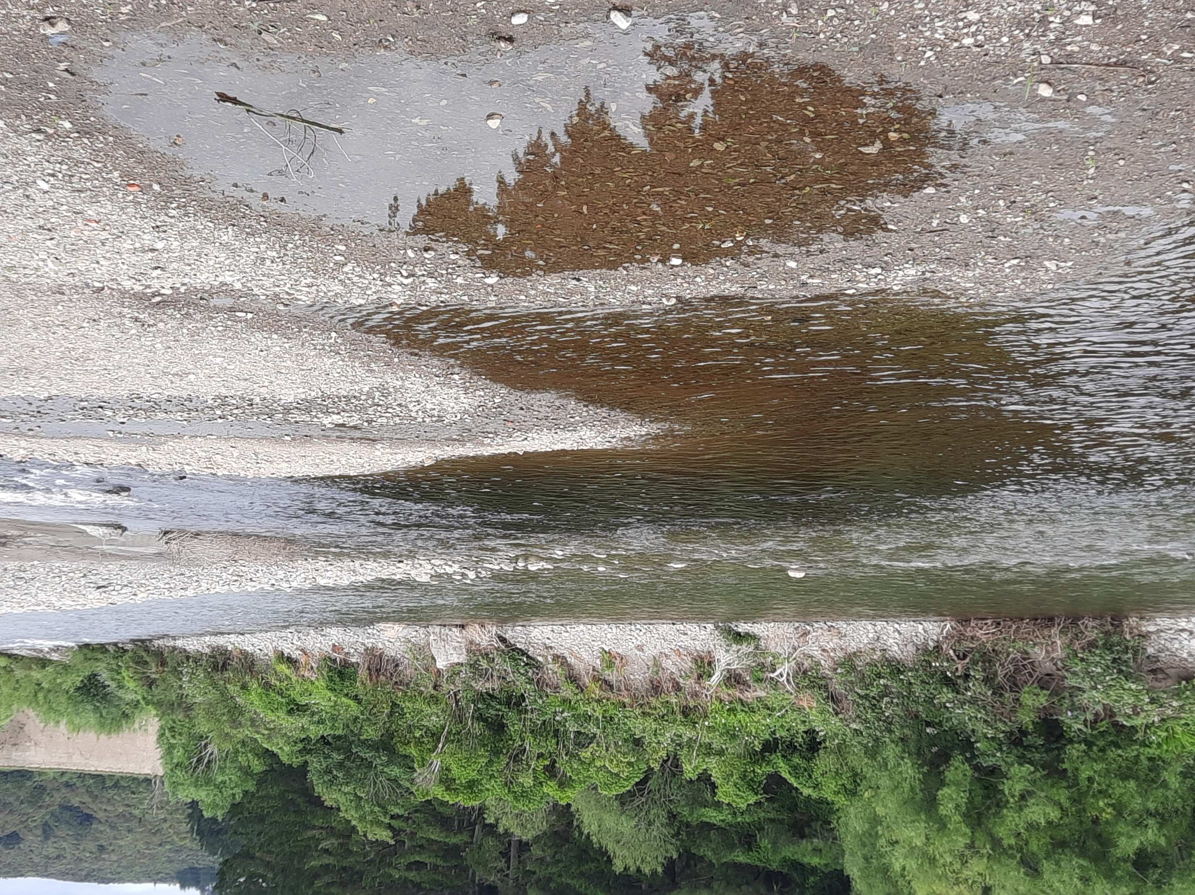
Wellington Farm Forestry PC1, Stream 2 Submission
Presented by Eric Cairns, Secretary Wgtn FFA
Notes:
Photo is confluence of Mangaroa River and the Hutt at Te Marua

Slide 2
Fresh Water Objectives not to override NES-PF
An MFE Guidance document says:
Regulation 7 of the NES-F specifies the NES-F regulations are subject to the NES-PF.
Where the NES-PF and the NES-F conflict or overlap, the relevant provisions of the NES-PF will prevail over those in the NES-F
In this plan change, GW propose that provisions of the NPS-FM will override the NES-PF and NES-CF.
Notes:
This MFE advice is also tempered with the need to provide sufficient stringency to warrant overriding the National Environmental Standard for Plantation Forestry (now NES-CF)

Slide 3
Natural State?
About 28 years of clarity data exist for Mangaroa River at Te Marua, without showing significant trends over time.
No publicly available clarity or sediment data for Tributaries
Expectation for natural state of sediment to revert to prehuman levels is unrealistic
National Bottom Lines become the default “Natural State”
Notes:
The photo is of Black Creek in January 2025. This is a modest tributary of Mangaroa River. It shows not only high levels of tea coloured tannins (CDOM), but also high levels of peat fragments as suspended sediment (the cloudiness and opalescence caused by light refraction of the particles)
Longer term history of land use in Mangaroa Valley
Many hills (re)cleared in 50-60s under pastoral farming incentives and ability to fly in fertiliser. The old air strips are still there
A lot of land has since reverted to scrub or converted to Plantation Forestry (so the proportion of the catchment in pasture is substantially less than is was 40-60 years ago)
Now a lot of lifestyle blocks and more intensive infrastructure, but that still occupies a very small % of catchment
Now no dairying, and we think much less intensive winter grazing (IWG)

Slide 4
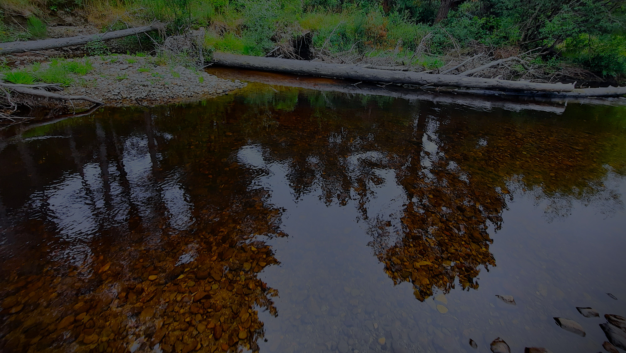
Median Visual Clarity TAS for Mangaroa River
We are pleased that GW scientists and consultants have acknowledged a natural brown water source that prompts resetting the TAS
We note that median historic clarity data over 28 years still only meets the revised target for 5 months each year
The revised target median Visual Clarity of 1.67m is based on a limited dataset and only deals with CDOM
It does not consider possible natural sources of suspended sediment
We ask that the revised TAS VC be treated as interim
Notes:
The back ground photo is from just below the confluence of Mangaroa River and Black Stream, (111C Mangaroa Valley Road)
Note; a minor level of colour adjustment is used to provide contrast for the slide

Slide 5
Measurement Uncertainty for Estimated Reductions in Sediment Yields
We agree with the reviewer and Mr Blyth that absolute estimates of suspended sediment based on dSedNet are unreliable and a distraction. They should not be tabulated
The revised TAS, for Mangaroa River, has resulted in a required 22% reduction in sediment
For Mangaroa River, both Dr Murray Hicks and Mr Blyth agree that relationships between TSS and VC at relevant VC levels (low flow) are unreliable
Our submission is that for Mangaroa River, that TSS is an unreliable indicator of VC and that therefore calculated percentage reductions in total sediment load are invalid
Also, the estimates do not take into account possible natural sources of suspended sediment
Notes:
22

Slide 6
TSS vs Adjusted Visual Clarity
Notes:
When Mr Blyth and others are creating calibration lines between TSS and median VC there are several basic assumptions that limit the validity of conclusions.
The first is that there exists a simple relationship (perhaps non linear, but “curved” power function) between VC and TSS across the whole dynamic range. It is very likely that is not true as:
Clarity, like turbidity, is highly dependent on particle size. High / flood flows will be dominated by mineral particles, medium flows a mix, but likely to be smaller particles and in the case of Mangaroa River, we think that low flows are dominated by organic peat and periphyton debris. In addition, the colour intensity will follow “beers Law” and at lowish colour intensities, there will be a linear relationship between concentration and optical density (colour intensity).
The second assumption is that total or annual loads of suspended sediment have a significant impact on median VC. However, perhaps greater than 95% of sediment loads occur during peak flows, which occur only <5% of the time (data from LAWA website, and backed up by Dr Murray Hicks). Median VC occurs at low flow conditions and any predictions for reduction in sediment load have to take that into account as suspended sediment types at those low flow levels are likely to be dominated by organic debris, including peat from Mangaroa Peatlands.
The methods used do not address sediment type at low flow levels, so the estimations for required reductions in sediment load are invalid.
To illustrate this, the plot between TSS and VC at the relevant adjusted VC, using the Valois data set, has contributions of CDOM (dark tannin stain) subtracted from the VC reading. It covers only the stipulated VC range (in the region of the TAS value). (Clarity shown here is adjusted to reflect what it would be without CDOM)
The limit of quantification for the TSS method is 3 mg/L. Normally values below LOQ and above Limit of Detection, are reported to only 1 significant figure. i.e. values below LOQ should be regarded as less accurate. A power function correlation line and clarity shown in inverse scale is chosen to match the data presentation given by Valois and Blyth. The very poor correlation coefficient suggests perhaps only a 5% dependence between the two variables.
We conclude that TSS is a very poor predictor of clarity in this range and that calculations for required sediment reductions are therefore invalid. Instead, more work is required to investigate sources and nature of sediment (along with seasonal variations), and that an appropriate water plan is implemented. This research should be done before implementing significant land use changes.

Slide 7
Seasonal Variation in Clarity and Water Flow
Visual Clarity
Flow Rate
Notes:
Both graphs show data collected over 28 years available from GW websites, but arranged by median values per month.
The Mangaroa River only exceeds the revised TAS (1.67m) for 5 months of the year.
There are very clearly seasonal effects occurring.
Valois says CDOM remains steady at different flow rates (but actually, for her limited data set, the g440 values varied from 3.52 to 7.31) and we think that this at least 2 fold variation is significant.
We say that proposing to use a fixed level TAS-VC is simplistic. More work needs to be done to find reasons for seasonal variation and identify the types and origins of sediment.

Slide 8
Misalignment of Policy Advice
We emphasise that advisory documents from MFE and NIWA to Regional Councils to calculate required total Annual Sediment reductions to meet TAS for clarity is an invalid process and could result in wildly inaccurate estimates for required land use changes
Notes:
The photo shows the culvert for Black Steam at Wallaceville road. The height measure, along with residence time in the culvert, can be used to estimate flow rates
The invalid process does not only refer to Mangaroa River. There are severe limitations to using TSS at levels close to the quantification limit and the presumption that a power fit for calibration lines is scientifically valid is quite dubious. Other river data needs to be replotted at appropriate levels. I would argue that R² above 0.9 is required to give confidence in required sediment load reductions
Should large percentage sediment load reductions be calculated with much greater confidence, such a result would then support plans to restrict land use rather than find land use practise options to mitigate suspended sediment.

Slide 9
Data from fixed monitoring points reveals limited information about upstream events
Both WFF and Wgtn FFA make this point
E Cairns carried out a short-term study for Visual Clarity at multiple points along Mangaroa River and some of its tributaries
Map shows main 8 sampling points studied (red dots)
Notes:
Point out recent forest harvest sites and urban development site plus Mangaroa peat lands and Black Stream

Slide 10
Notes:
Early and revised periscope and measuring equipment

Slide 11
Notes:
Mangaroa Hutt confluence on left You can see the darker water contrasting with the main river
Blaikies Stream culvert on the right, showing foam and discoloration

Slide 12
Variation of Clarity within Mangaroa Catchment
Sampling Site/ Date | 17 Jan | 29 Jan | 4 Feb | 9 Feb | 12 Feb | 19 Feb
Mangaroa River at Te Marua below SH2 bridge | 1.45 | 2.2 | 2.15 | 2.7 |  | 2.05
Blaikies Stream just downstream of culvert in Maymorn Rd |  | 1.13 | 1.0 (0.68) |  | (0.58) | (0.56)
Colletts Stream at Colletts Rd | 2.05 | 1.9 | 1.7 |  |  | 1.9 (0.84)
Cooleys Stream at Mangaroa Valley Rd | >2.6 |  | 3.1 |  |  | >3.3
Mangaroa River at Mangaroa Hill Rd | 1.45 | 2.4 | 1.5 | 2.2 |  | 2.1 (0.88)
Black Stream at Wallaceville Road culvert | 0.26 |  | (0.10) | (0.13) |  | (0.13)
Mangaroa River at intersection between Mangaroa Valley Rd and Whitemans Valley Road | 2.2 | 2.55 | 2.85 | 2.15 | 2.18 | 2.32
Stream adjacent to 836 Whitemans Valley Road (near Russells Rd) |  |  | 0.55 (0.26) |  | (0.77) | (0.76)
Notes:
Data from Jan/Feb 2025
Visual clarity in M
Bracketed data is via a SHMAK tube and is typically a shorter measurement, This device is typically used where VC is less than 1m. It splits the view of a black duster against a more distant black background, but is subject to high light intensity and so the more intense light scattering restricts the viewers ability to distinguish a black object against a black background
What the data shows:
On any particular day, there can be a wide variation in VC up and down the river
At the confluence with Black Stream, VC dropped by 1.3m (29 Jan 2025) (not actually tabulated)
Streams below two recent forest harvest sites gave lower VC readings than expected, but we don’t know how quickly these will recover.
Blaikies Stream, draining an active subdivision, and in spite of engineered sediment traps, was still leaking suspended sediment
During this period, the water clarity of the main river at Te Marua, was mostly above the recommended TAS of 1.67m
Even when clarity at Te Marua failed, there were sites upstream that complied (>2.2m).
Periphyton levels were also quite variable, but mostly in the lower reaches. Periphyton have a role to play both in trapping/removing sediment and creating it, as it breaks down.
Black Stream confluence data not shown in table

Slide 13
What the data shows (this slide NOT USED)
On any particular day, there can be a wide variation in VC up and down the river
At the confluence with Black Stream, VC dropped by 1.3m (29 Jan 2025)
Streams below two recent forest harvest sites gave lower VC readings than expected, but we don’t know how quickly these will recover.
Blaikies Stream, draining an active subdivision, and in spite of engineered sediment traps, was still leaking suspended sediment
During this period, the water clarity of the main river at Te Marua, was mostly above the recommended TAS of 1.67m
Even when clarity at Te Marua failed, there were sites upstream that complied (>2.2m).
Notes:
Periphyton levels were also quite variable, but mostly in the lower reaches. Periphyton have a role to play both in trapping/removing sediment and creating it, as it breaks down.
Black Stream confluence data not shown in table

Slide 14
Consequences of not achieving TAS
Consequences
Required Actions
Various land use activities above a non complying sample site may be restricted
Even if sub catchments comply
This will penalise innocent parties
There may be little proof of any misdemeanours or poor practise
Properly investigate
Identify nature and sources of suspended sediment in sub catchments
Focus mostly on land use practises than could affect median VC
Document history and changes for of all relevant land use practises
How to unbundle climate change effects from human induced
Notes:
The previous slide does beg the question, how can you restrict business operations in an FMU when a single sampling point does not reveal whether business operations in sub-catchments comply or fail.
The process for deciding failure to meet TAS (based on median VC values) still has to be described. Is it failure upon spot check (> 1g/m³) or following a trend or after 60 sampling points over several years, and what about seasonal effects
So if active management to mitigate sediment has been attempted, but TAS is not achieved….
. Land use activities that are controlled may escalate to discretionary or prohibited status
What happens to uncontrolled activities (e.g. pastoral farming or horticulture?)
So potentially climate change effects, or a suburban land development could prevent forestry harvesting occurring
Required actions:
Properly investigate and also Identify land use practises most likely to affect median VC (it might be driving utility vehicles along gravel roads or stock access to waterways)

Slide 15
10 years Clarity data Horokiri Stream
Notes:
I want to show that forestry harvesting may have very little impact on median VC
This slide shows clarity data over ten year for Horokiri Stream. January 2015 to Jan 2025, covering the period of Transmission Gully Construction,
Forestry harvest is mostly over the last 3 years. (a small amount before 2017)
Median clarity for the stream for the 10 year period, calculated by me from published data, was 2.6m. The TAS is 2.3m
Some very low VC points did not correspond to flood events.
In spite of extensive earthworks since 2017 (motorway plus harvesting), median VC is maintained

Slide 16
Puketiro Forest Harvest adjacent to Horokiri Stream
Notes:
Jan 2025 photo. View looking across Transmission Gully Motorway (from Battle Hill Regional Park)
Some harvesting was still underway when this photo was taken. The dust trail in the middle is from a logging truck carrying out a full load of logs

Slide 17
Extensively (Plantation) forested catchments with A grade sediment scores and clarity exceeding TAS
Whakatikei (red outline)
Akatarawa (including Hukinga)
Pakuratahi
Horokiri
Notes:
Grade A relates to river quality for both suspended and deposited fine sediment, as well as visual clarity
The aerial photo shows Whakatikei catchment, approximate boundary outlined in red (LINZ 3D)
Hard to see, but darker green is Pine forest. There are extensive harvested areas in this 2017 image
(Transmission Gully earthworks have started. The northern part of Puketiro slopes have been recently harvested by that stage

Slide 18
Whakatikei Catchment
Catchment outlined in red
Its huge
Mid and lower reaches are dominated by Plantation Forestry
Only tiny areas with low intensity hill country pasture and small urban area (Riverstone Tces)

Slide 19
Summary
Fresh Water objectives should not override NES-PF
The Natural State of some of our rivers and their tributaries is ill-defined
The TAS, Median Visual Clarity for Mangaroa River; accept revised figure as an interim value
Estimated required reductions in sediment are invalid and policy should focus on other ways of improving VC

Slide 20
Summary, Continued
There is a policy misalignment between required reductions in total sediment and meeting median Visual Clarity (VC)
Data obtained from fixed monitoring points do not reflect what’s happening upstream
Repercussions and process for not achieving TAS
There are minimal effects on median VC for forestry harvesting in Wgtn region
Our major catchments with PF are Grade A for sediment

Slide 21
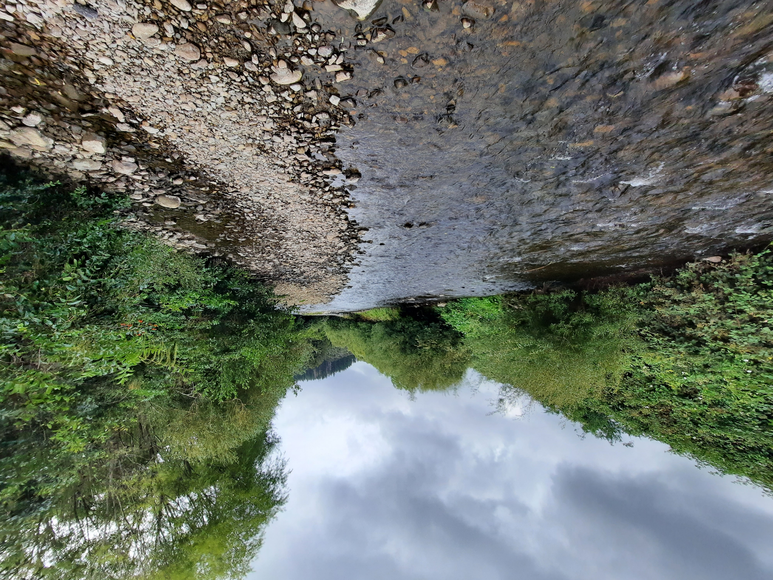
Presentation Ends

